Slide 1
The UK productivity problem Johnny Lau
Can we have more for less?

Slide 2
Definition
“Productivity is commonly defined as a ratio between the output volume and the volume of inputs.
How efficiently production inputs, such as labour and capital, are being used in an economy to produce a given level of output.
Over the past decade, productivity has slowed down globally with the UK lagging behind some other developed economies.
Productivity is key to the development of local businesses and the wider economy.

Slide 3
Approach
Fully understand client brief
Differentiate from other consultants’ briefs
Selectivity with the extensive datasets
Adding value to the data
Providing insight

Slide 4
Client brief
How can we improve productivity within Scotland and the UK overall?
Which industries are lagging behind in terms of productivity and how could they catch up?
What factors can be improved to increase employee and/or business productivity across UK regions?
Can we predict overall UK productivity rates?

Slide 5
Analysis
Verify assertions
Comparison versus UK history and other countries
Emphasis on Scottish insights
Identify poorly performing sectors
Identify poorly performing regions
Identify biggest bang for buck
Create model to understand specifics of UK productivity
Identify most feasible area to focus on
Work with client on implementation

Slide 6
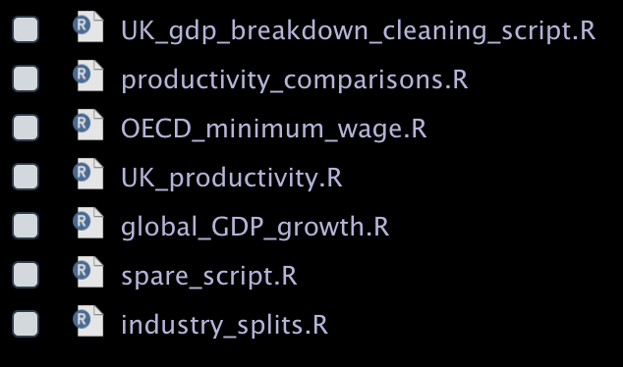
Challenges
Very wide data
Spreadsheets with multiple tabs
High volume of data
Data from different sources
Different sector classifications
Different time periods
Different category splits
Different sides of same D10 – e.g. output per
Organisation
Focus
Keeping code DRY

Slide 7
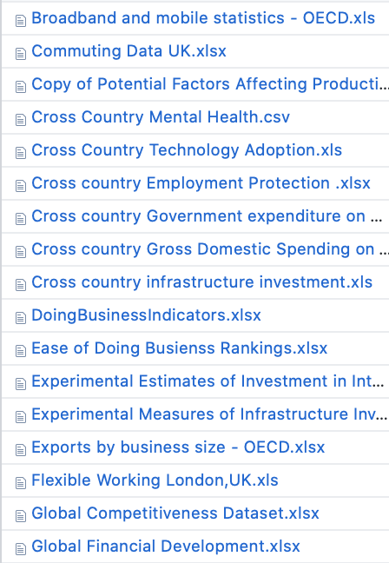
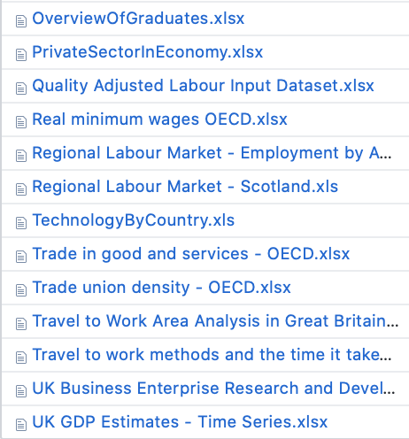
Additional data
Bin

Slide 8
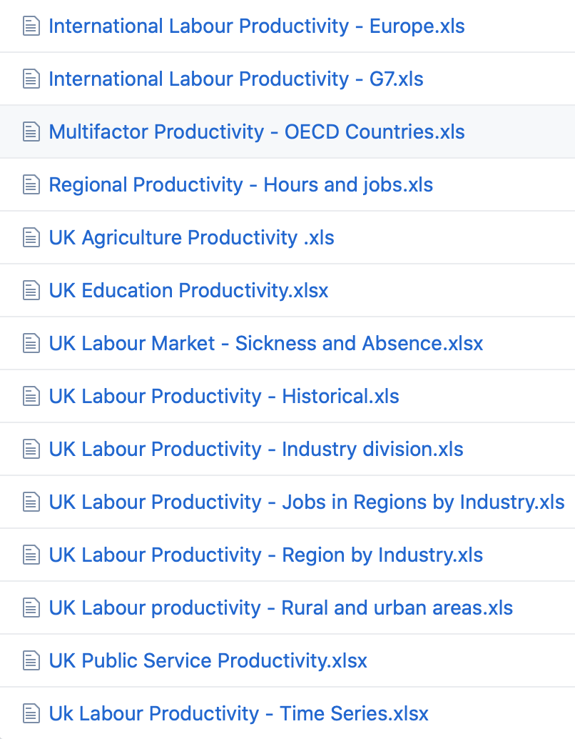
In the data folder

Slide 9
What’s your problem?

Slide 11
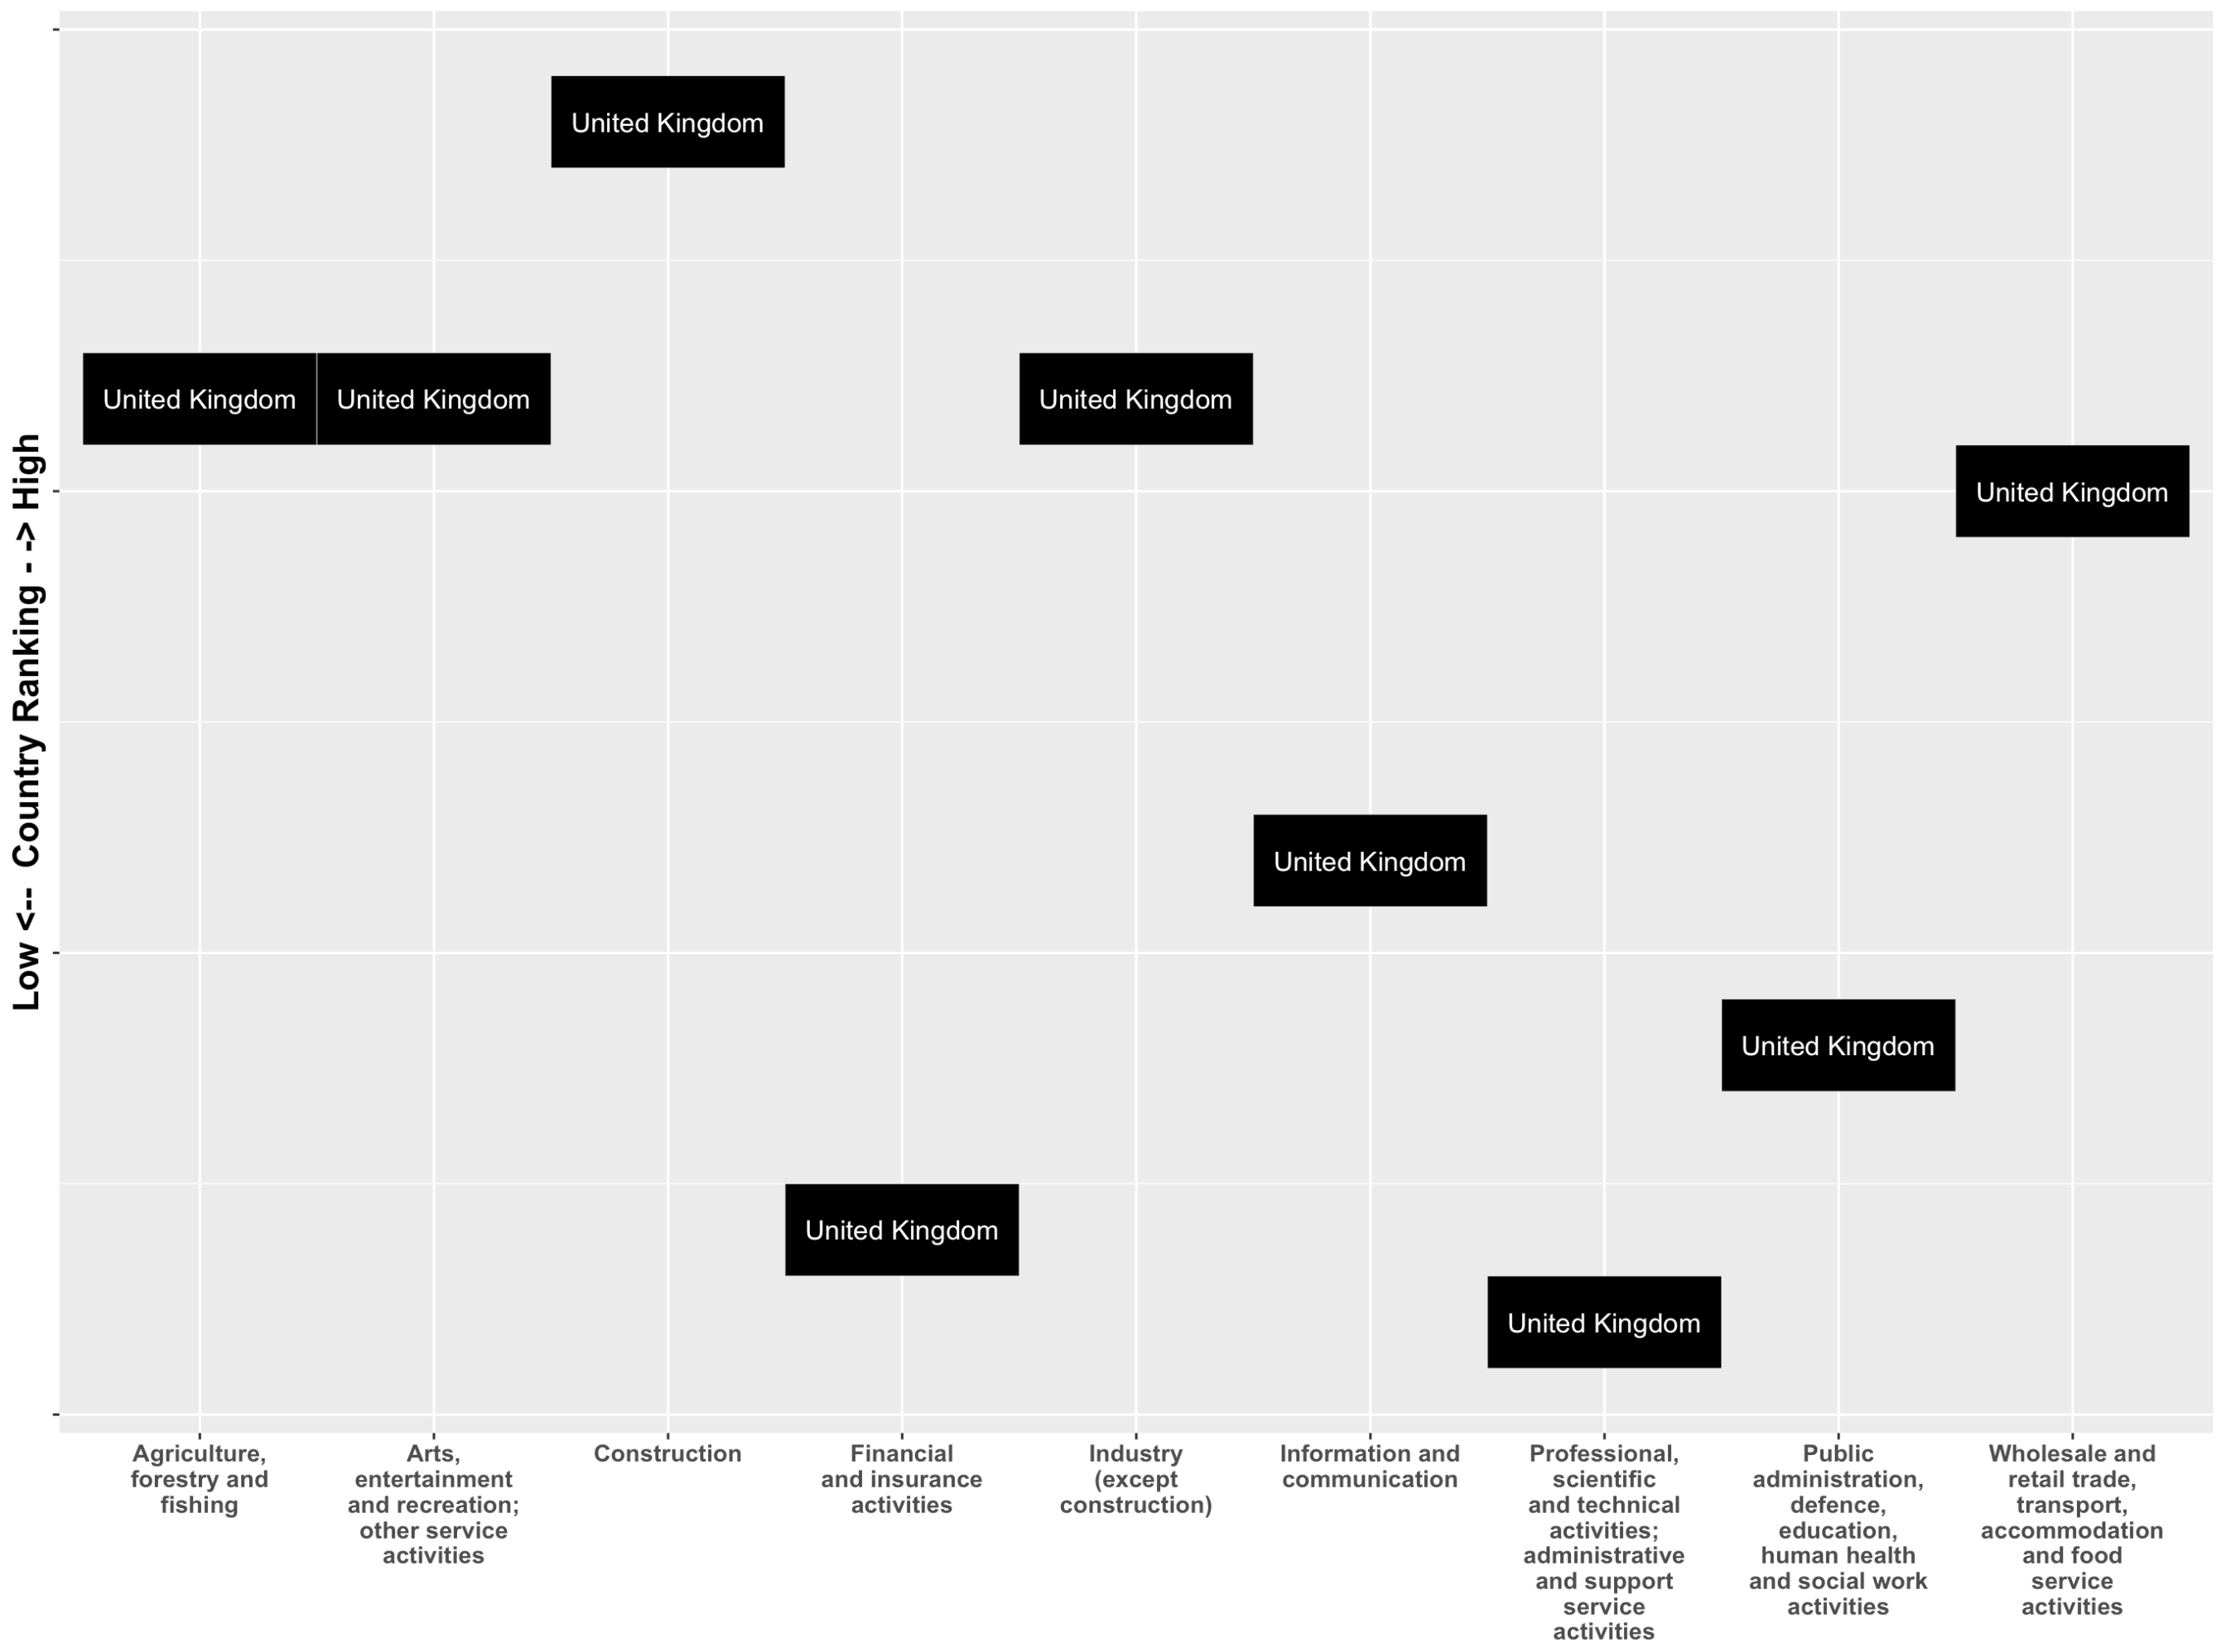

Slide 12
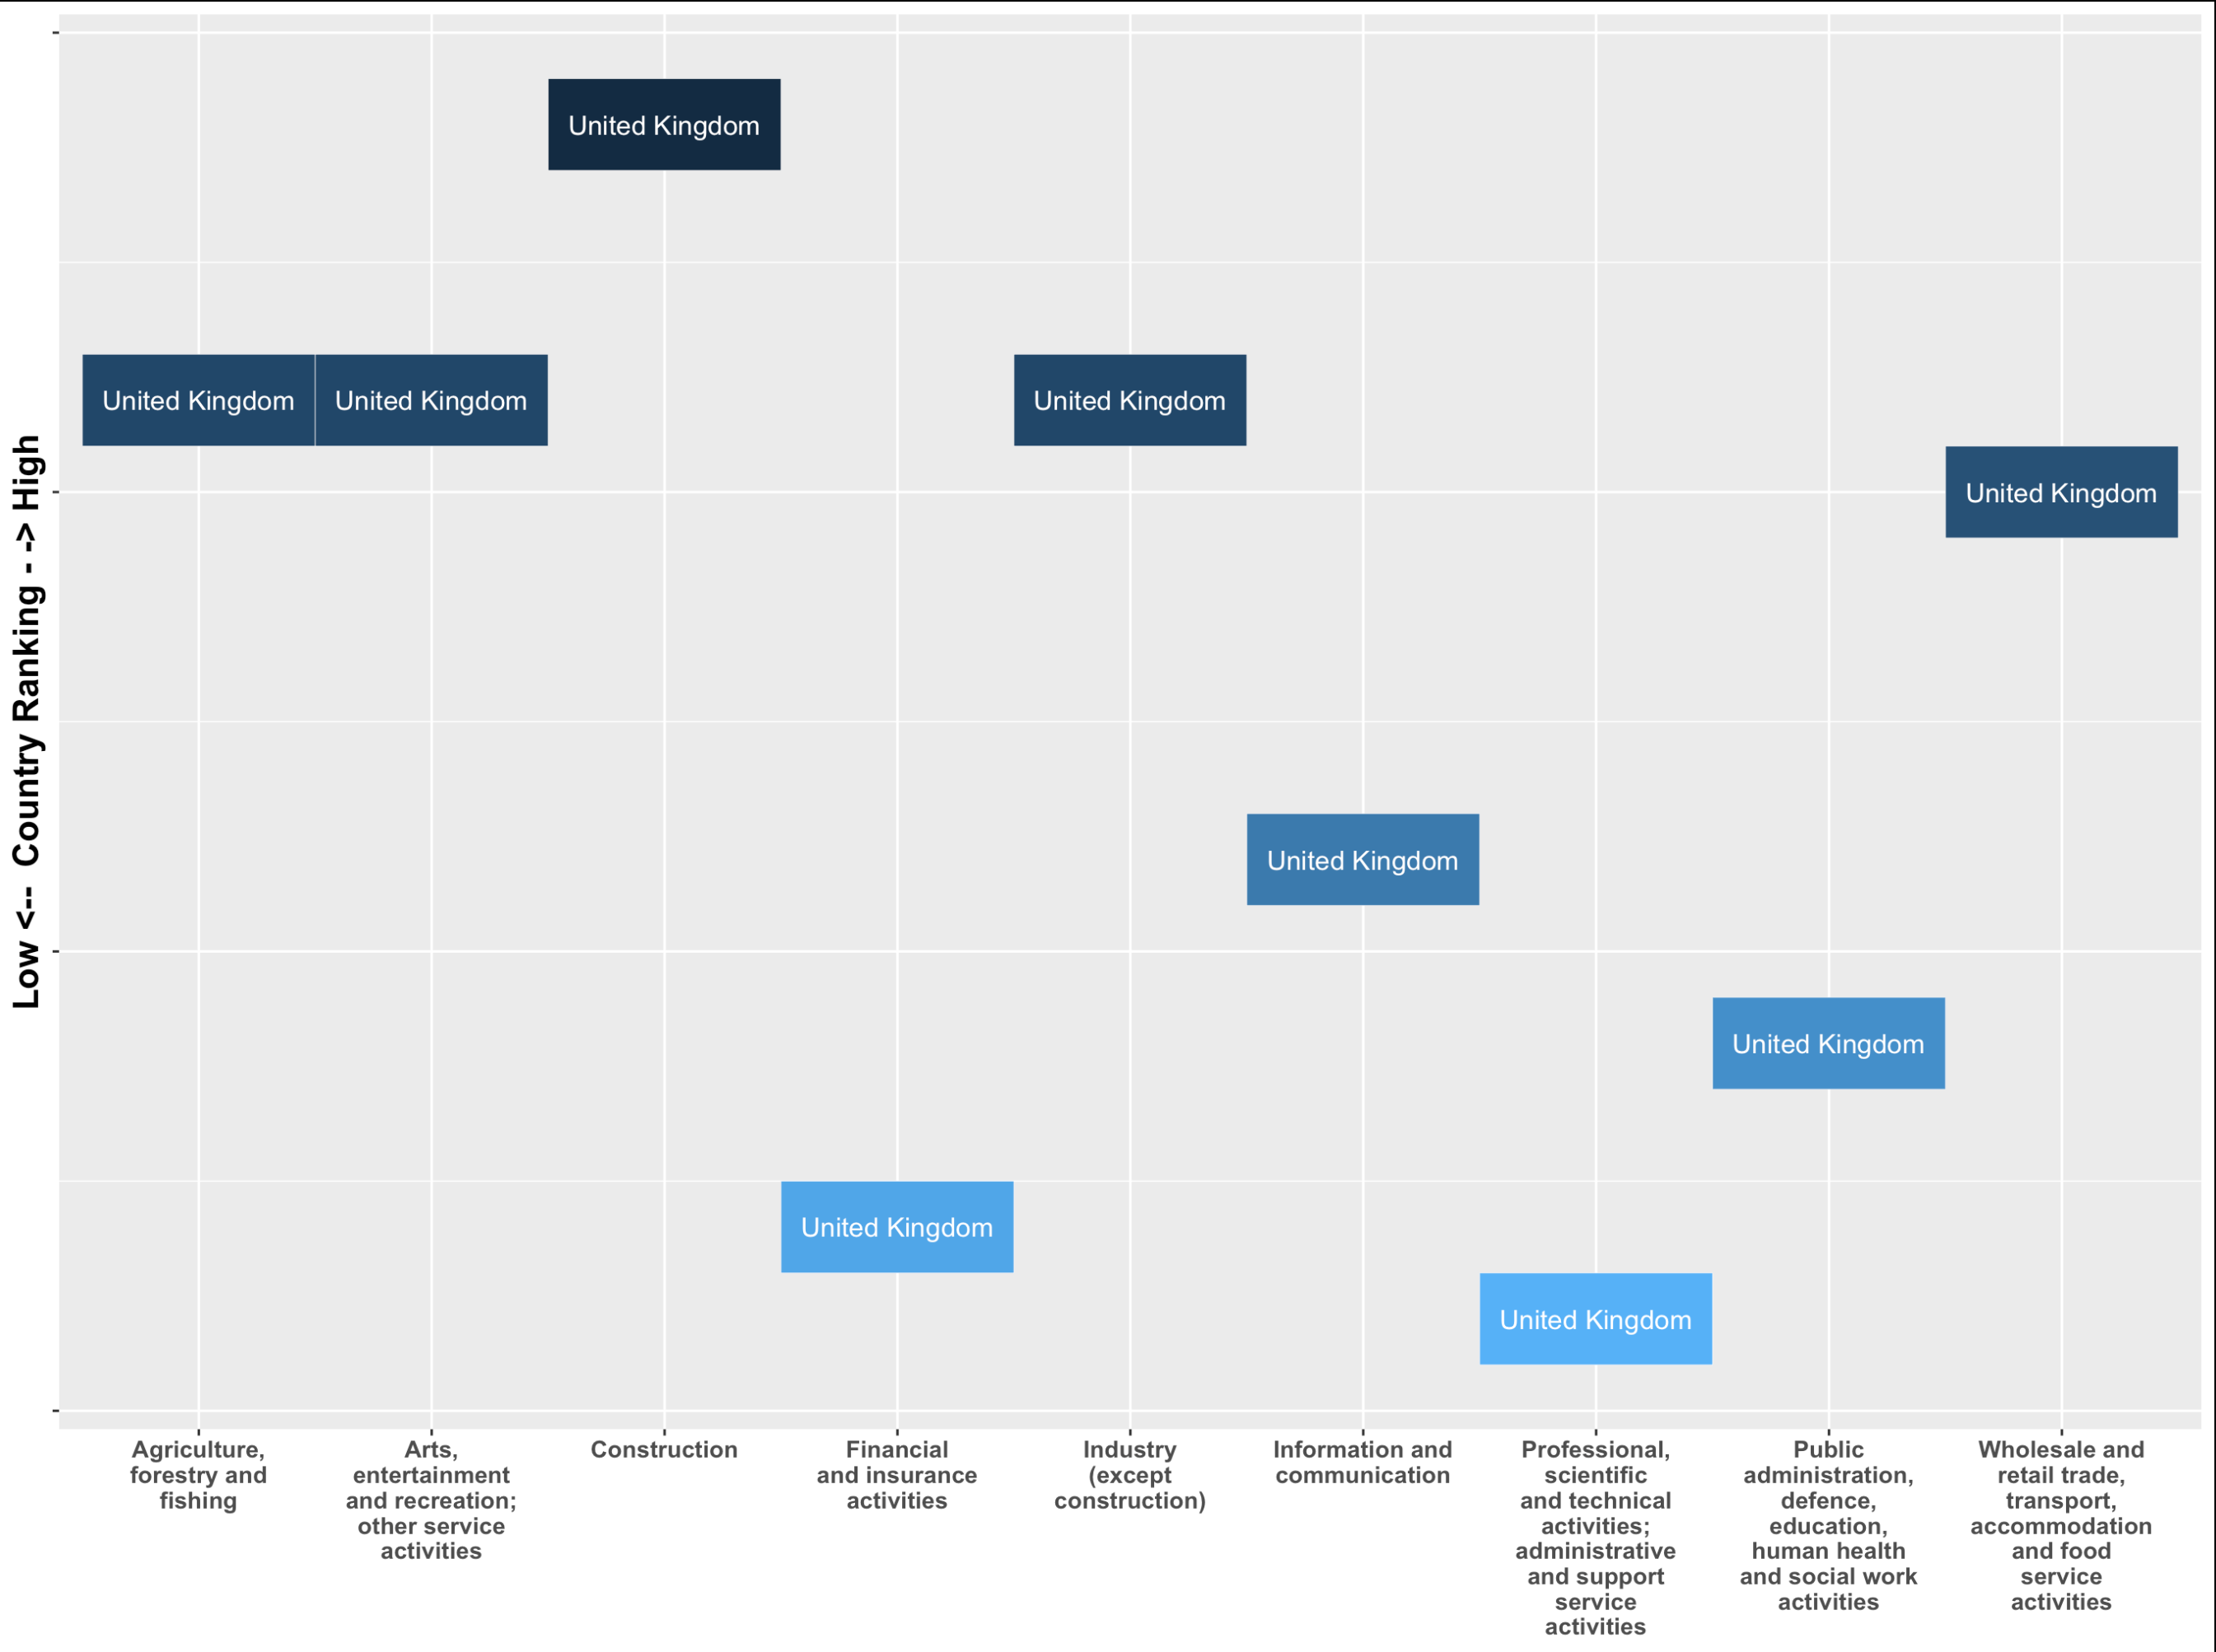

Slide 13
Professional, scientific and technical

Slide 14
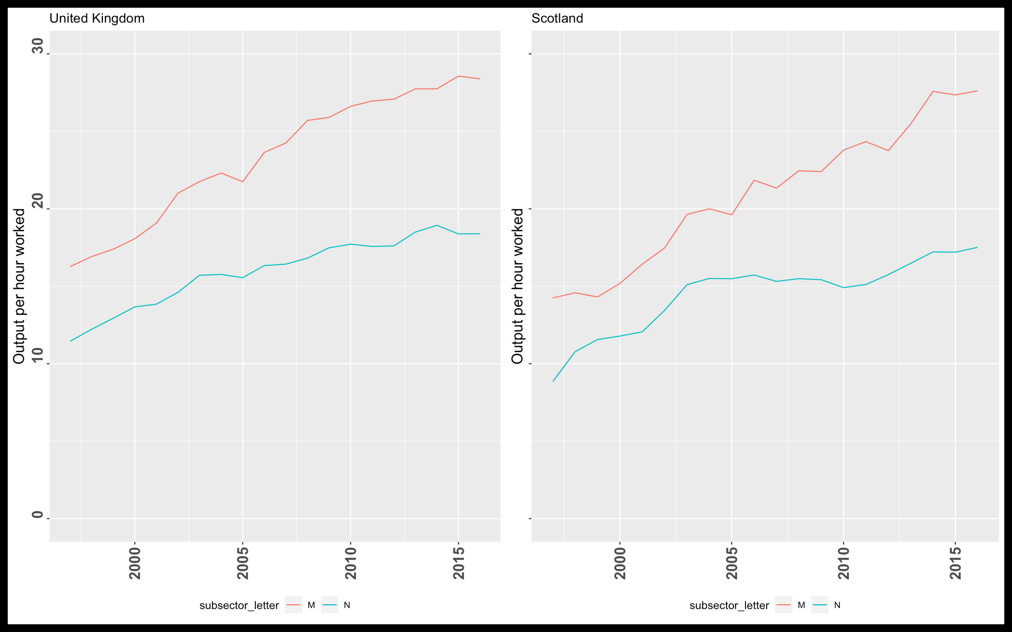
Professional, scientific and technical

Slide 15
Professional and business services

Slide 16
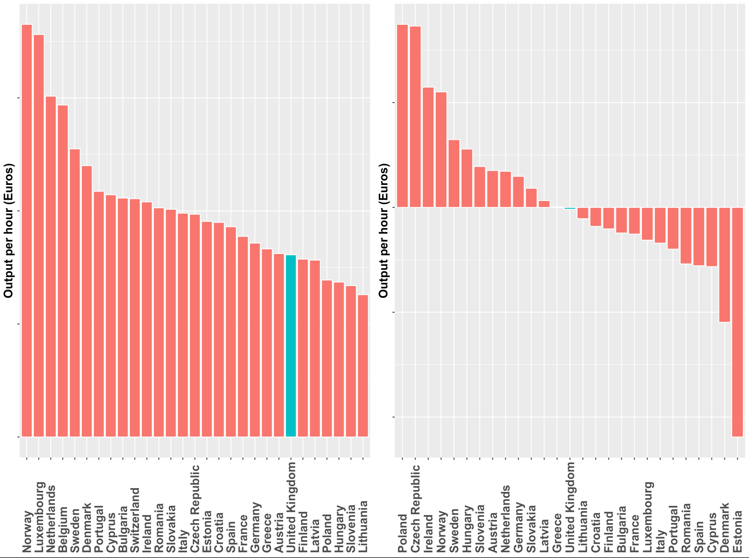
Financial and insurance activities

Slide 17
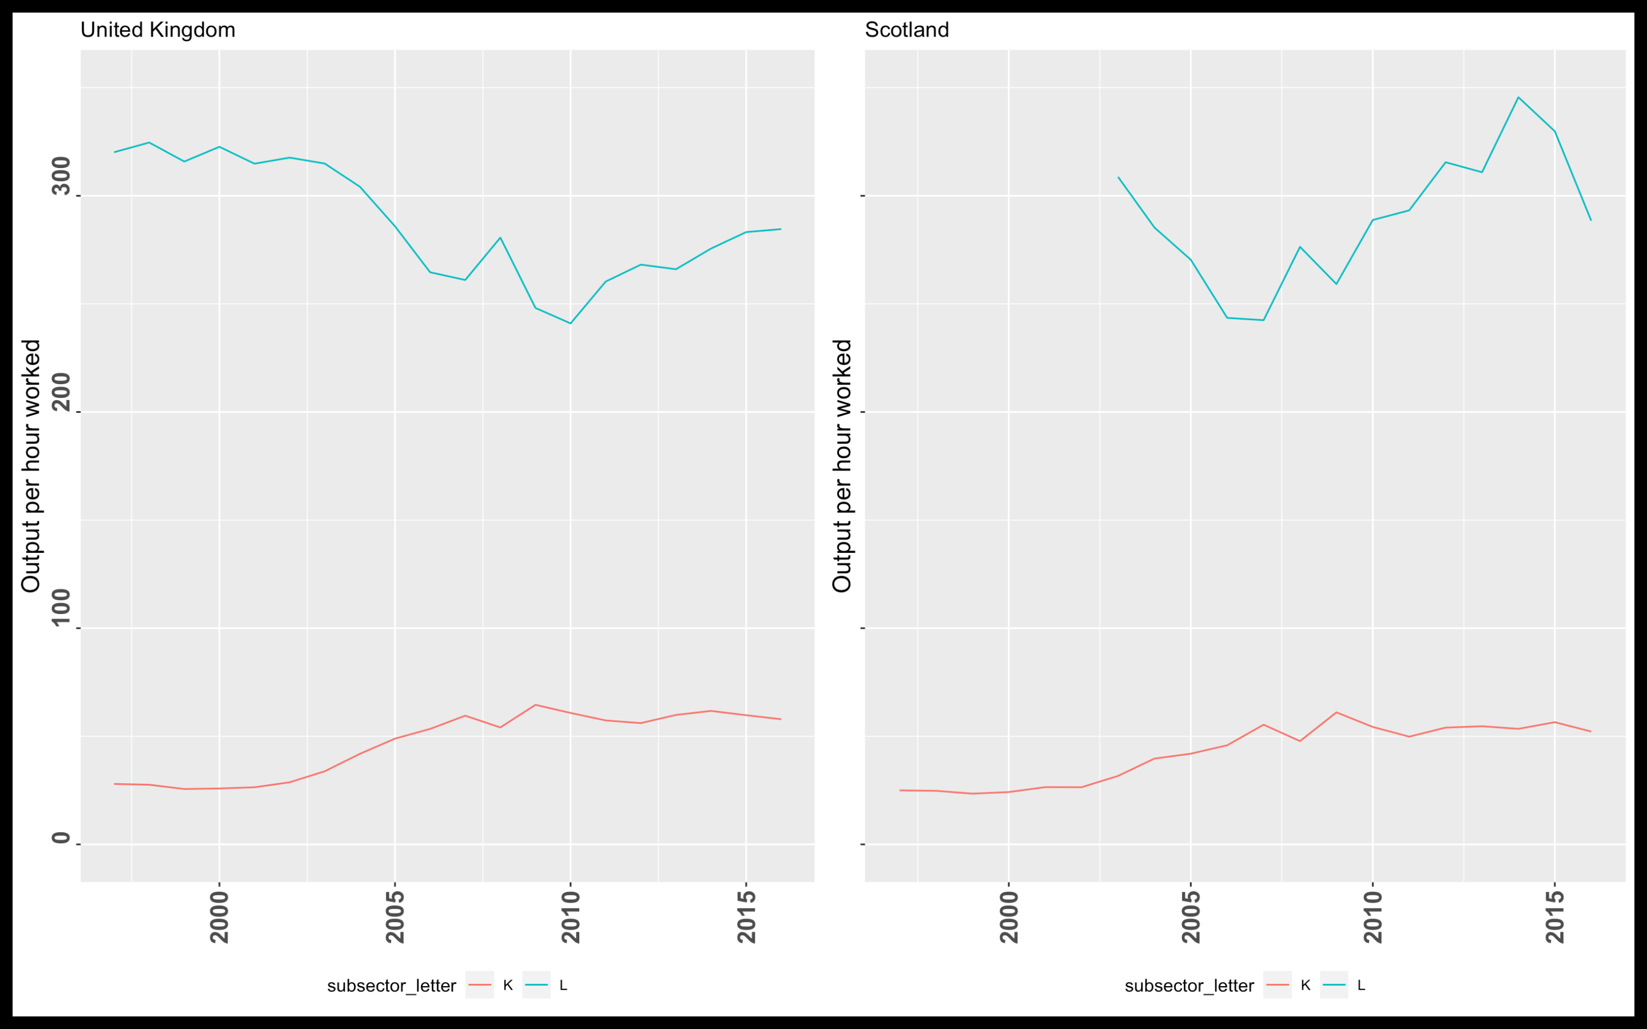
Financial and insurance activities

Slide 18
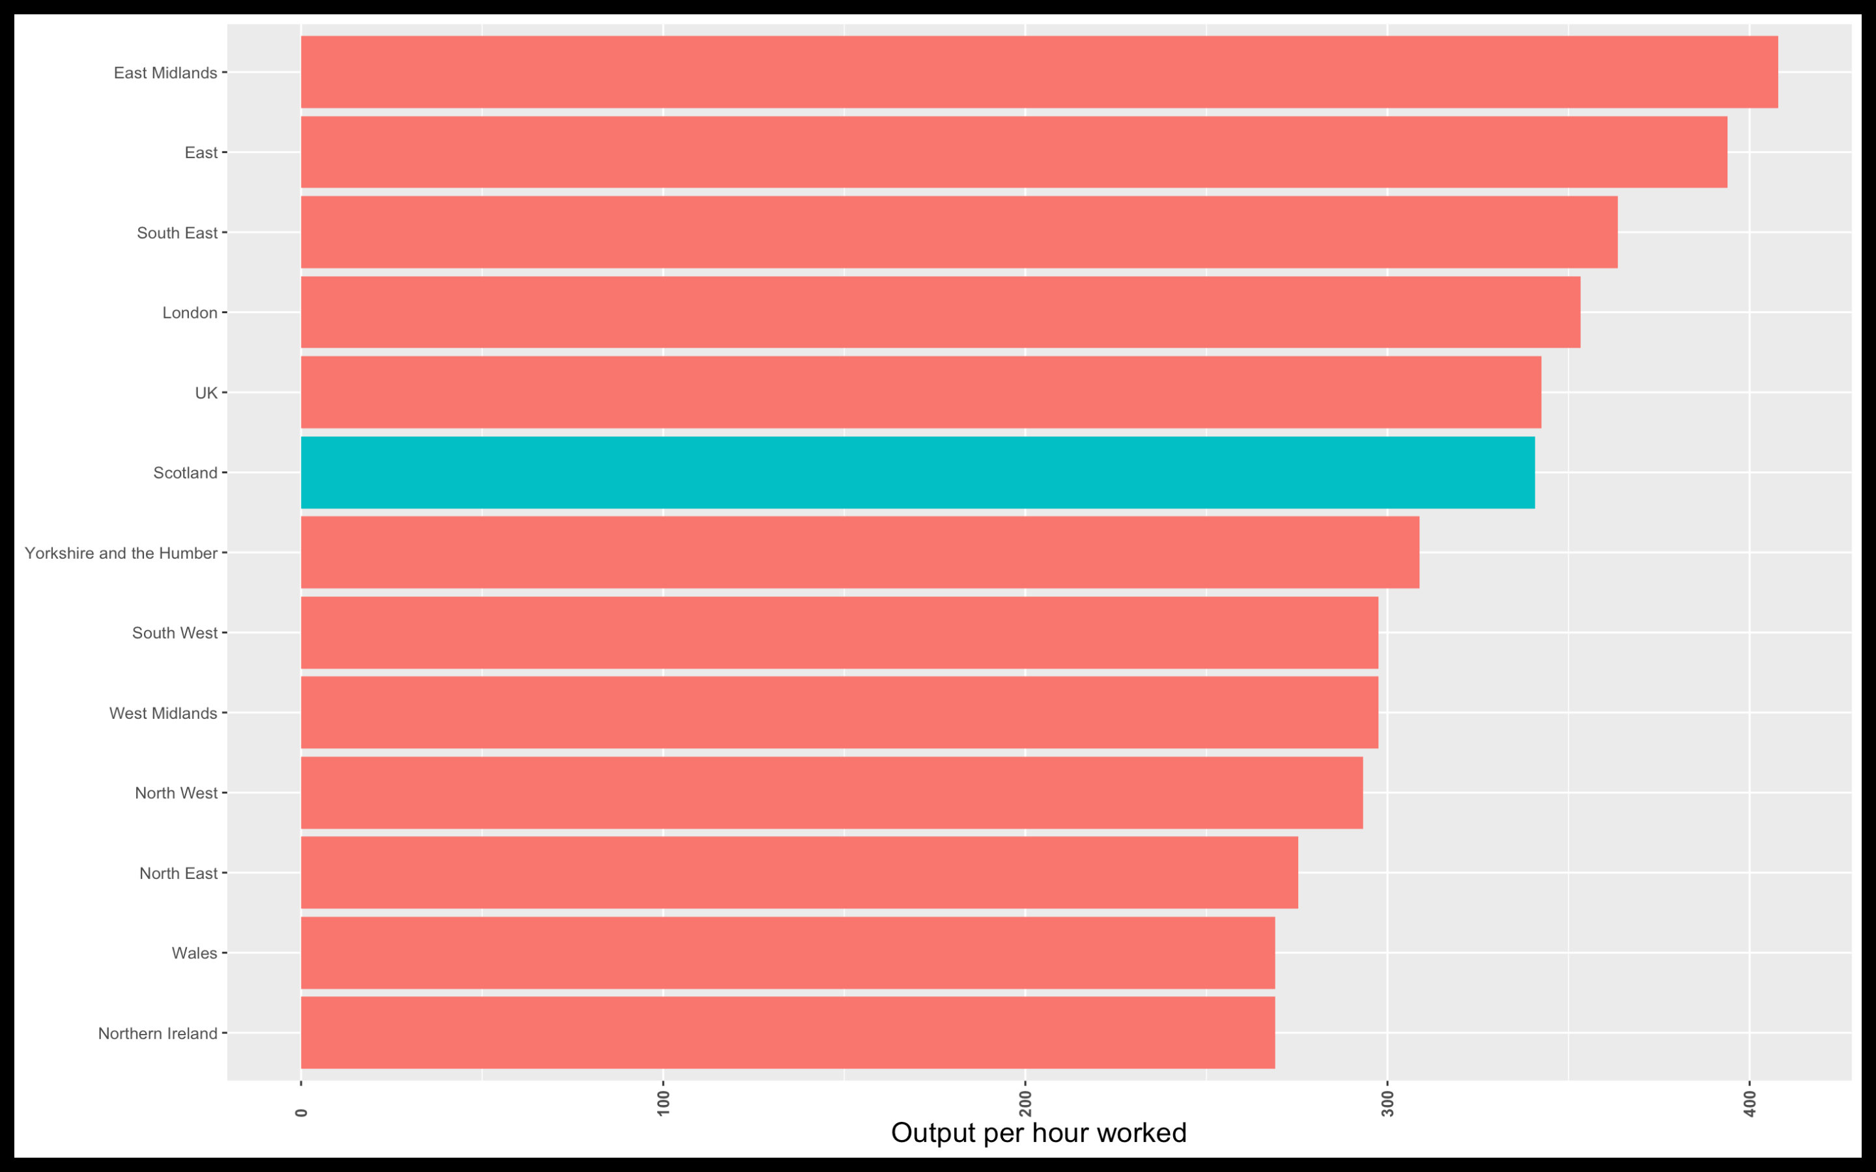
Financial and insurance activities

Slide 19
Public admin, defence, education, human health and social work

Slide 20
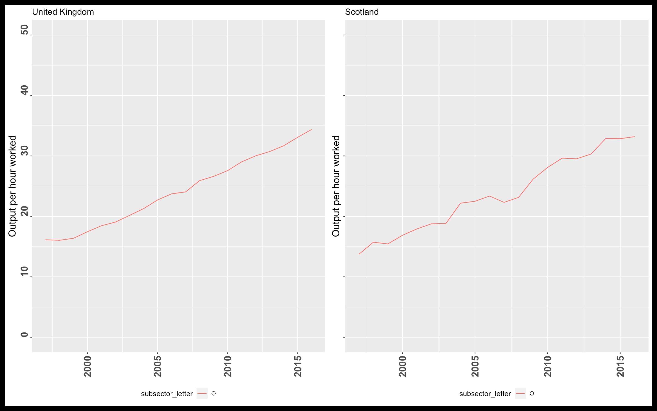
Public Admin and Defence

Slide 21
Public admin and defence

Slide 22
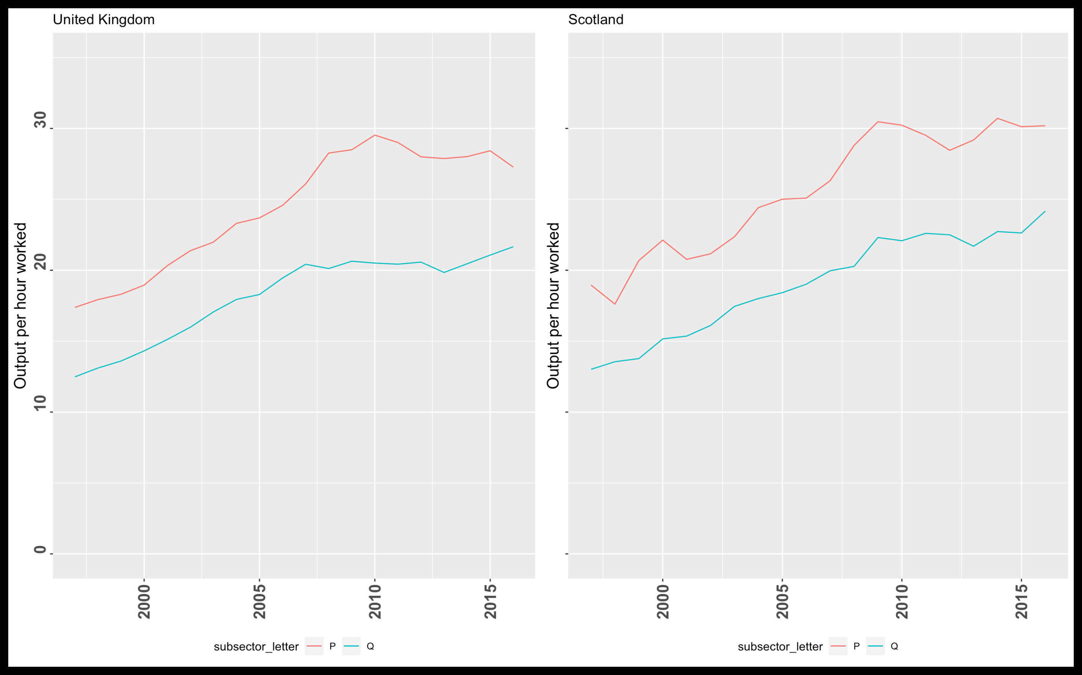
Health and education

Slide 23
Health and education

Slide 24
Caveats to the analysis
More work to be done
”Headline” figures only
Relationships may be more complex / structural /regional/ country specific
Productivity != productivity growth

Slide 25
Review versus EU28
Versus EU28 UK is weakest in
Professional, science and business services
Irish productivity growth versus Croatia
Switzerland productivity versus Greece
Financial and insurance activities
Polish and Cazech productivity growth versus Estonia
Norweigan and Luxembourg productivity versus Lithuania
Public admin, defence, education and health
Latvian productivity growth versus Romania
Netherlands and Italian productivity versus Sweden

Slide 26
Review for Scotland
Scotland is doing well versus UK in
Health and education
Scotland is doing poorly versus UK in
Public admin and defence
Scotland could be doing better versus UK in
Financial and insurance activities

